Slide 1

7th Grade Math
Unit 8, Lesson 1 Product Laws of Exponents Volume 2, pg. 3

Slide 2


Benchmark
MA.7.NSO.1.1
Know and apply the Laws of Exponents to evaluate numerical expressions and generate equivalent numerical expressions, limited to whole-number exponents and rational number bases.
volume 2, pg. 3

Slide 3
Integrated Mathematical Thinking and Reasoning Standards
MA.K12.MTR.1.1 Actively participate in effortful learning both individually and collectively.
MA.K12.MTR.4.1 Engage in discussions that reflect on the mathematical thinking of self and others.
MA.K12.MTR.5.1 Use patterns and structure to help understand and connect mathematical concepts.
MA.K12.MTR.6.1 Assess the reasonableness of solutions.
volume 2, pg. 3

Slide 4

Learning Target
I can explain and use the power of a product, power of a power, product of powers, and identity laws of exponents.
volume 2, pg. 3

Slide 5

Warm-Up
volume 2, pg. 3

Slide 6
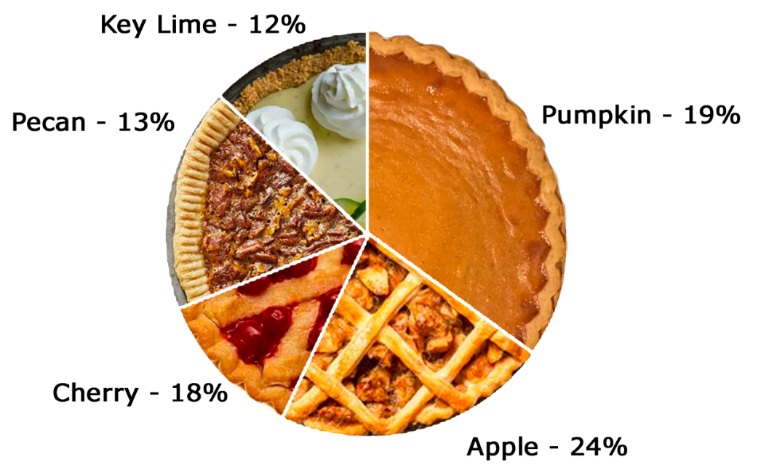
8.1.1 Warm-Up: Math Fail
The picture is an example of a “math fail.”
Explain the error shown in the image with your partner.
volume 2, pg. 3

Slide 7

Exploration
volume 2, pg. 4

Slide 8

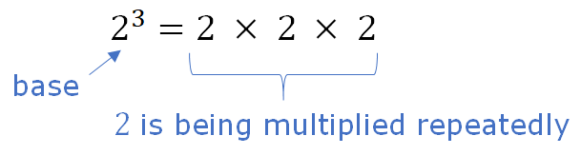

8.1.2 Exploration: Product of Powers Exponent Law
Recall that repeated multiplication is a way of writing a number with an exponent.
The number 2, called the base, is being multiplied repeatedly.
A base is the number used as a factor in exponential form.
volume 2, pg. 4

Slide 9
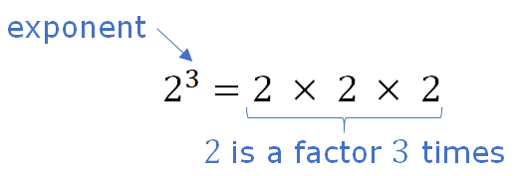
Since the base, 2, is a factor 3 times, the exponent is 3.
An exponent is the number of times the base occurs as a factor.
volume 2, pg. 4

Slide 10
With your partner, use the definition of an exponent to complete the table.
Write each product as a repeated multiplication expression. Then, write each expression with an exponent.
Product | Repeated Multiplication | Power of the form a^{b}
2² ⠂2³ | (2 ⠂2) ⠂(2 ⠂2 ⠂2) = 2 ⠂2 ⠂2 ⠂2 ⠂2 | 2⁵
3⁵ ⠂3⁴
5¹ ⠂5⁴ ⠂5³
volume 2, pg. 4

Slide 11

How do the exponents in the first column relate to the exponents in the last column?
What do you notice about the bases in all three columns?
Write a rule for the product of two exponential expressions with the same base.
Product of Powers Exponent Law
When multiplying two powers that have the same nonzero base, ______ the exponents and keep the same base.
volume 2, pg. 4

Slide 12
With your partner, follow the steps.
Determine which column you will start in, and which column your partner will start in.
Using the directions for your column, evaluate the expression. Your partner should use the directions in their column to evaluate the same expression.
Verify if your answers are the same. If not, find the error(s).
After each problem, switch columns.
volume 2, pg. 5

Slide 13
The first expression has been evaluated.
Evaluate each power, then multiply. | Apply the product of powers exponent law, then evaluate the power.
7² ⠂7¹
6⁹ ⠂6³
volume 2, pg. 5

Slide 14
Evaluate each power, then multiply. | Apply the product of powers exponent law, then evaluate the power.
(-8)⁴ ⠂(-8)⁵
volume 2, pg. 5

Slide 15
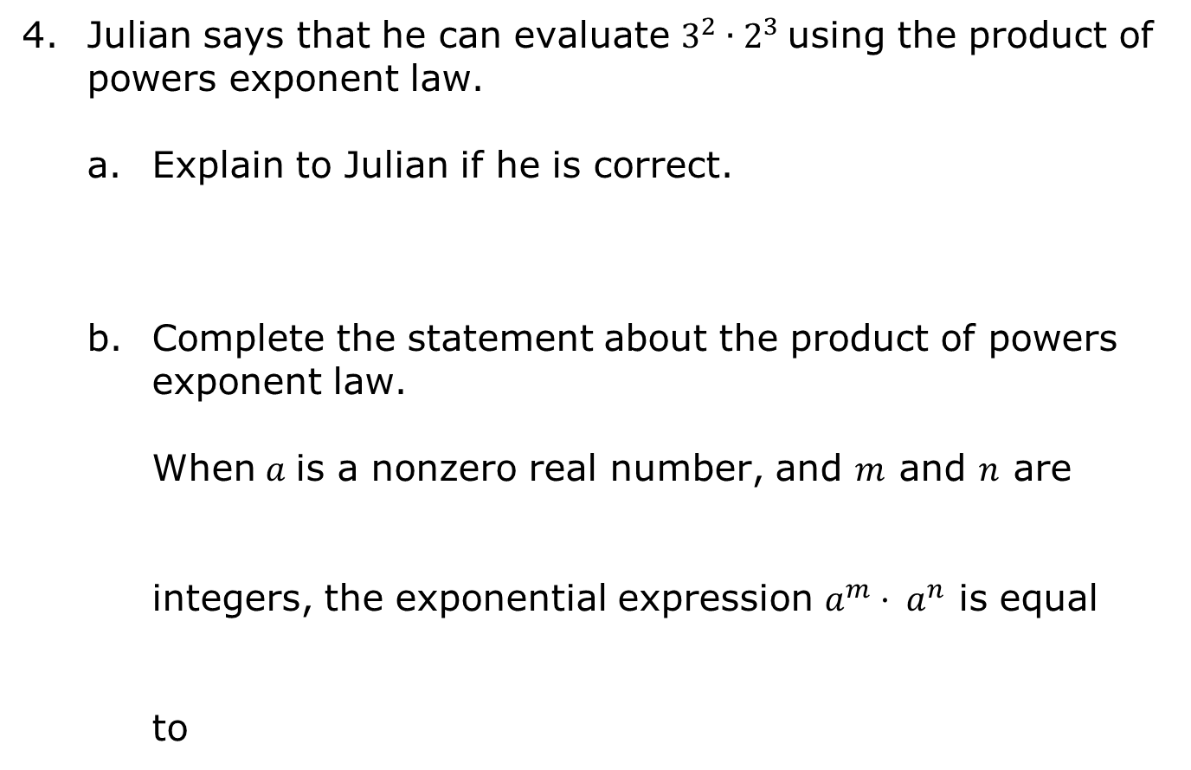
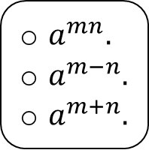
volume 2, pg. 6

Slide 16
Exploration
volume 2, pg. 6

Slide 17
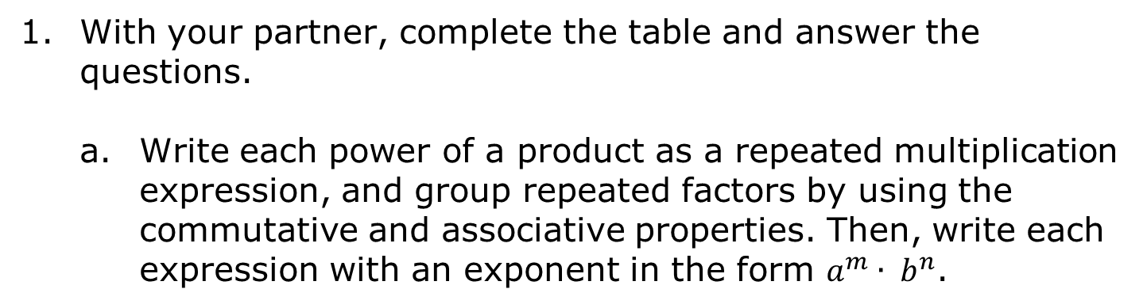

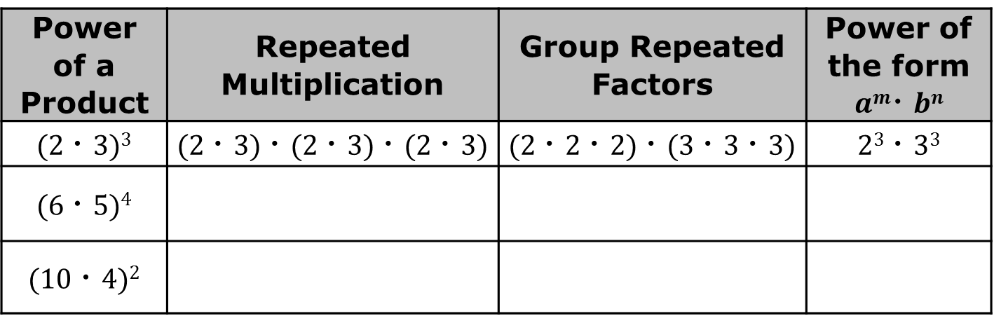
8.1.3 Exploration: Power of a Product Exponent Law
Power of a Product | Repeated Multiplication | Group Repeated Factors | Power of the form $am⠂bn$
(2 ⠂3)³ | (2 ⠂3) ⠂(2 ⠂3) ⠂(2 ⠂3) | (2 ⠂2 ⠂2) ⠂(3 ⠂3 ⠂3) | 2³ ⠂3³
(6 ⠂5)⁴
(10 ⠂4)²
volume 2, pg. 6

Slide 18
How does the base in the first column relate to the bases in the last column?
How does the exponent in the first column relate to the exponents in the last column?
Write a rule for the power of a product.
volume 2, pg. 6

Slide 19
With your partner, follow the steps.
Determine which column you will start in, and which column your partner will start in.
Using the directions for your column, evaluate the expression. Your partner should use the directions in their column to evaluate the same expression.
Verify if your answers are the same. If not, find the error(s).
After each problem, switch columns.
Power of a Product Exponent Law
When raising a product to a power, distribute the power to each factor.
volume 2, pg. 6

Slide 20
The first expression has been evaluated.
Evaluate inside the parentheses, then apply the exponent. | Apply the power of a product exponent law, then evaluate the power.
(-5 ⠂6)²
(-5 ⠂6)² (-30)² (-30) ⠂(-30) 900 | (-5 ⠂6)² (-5)² ⠂6² 25 ⠂36 900
(-6 ⠂4)⁵
volume 2, pg. 6

Slide 21
Evaluate inside the parentheses, then apply the exponent. | Apply the power of a product exponent law, then evaluate the power.
(-3 ⠂-2)⁸
volume 2, pg. 6

Slide 22
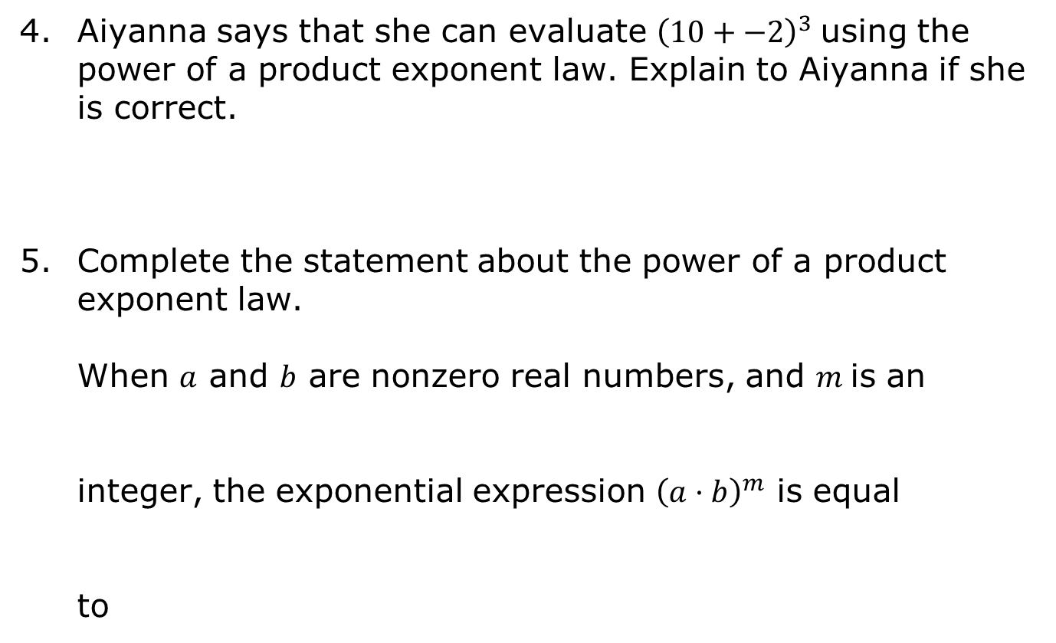
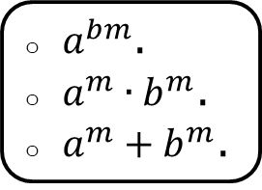
volume 2, pg. 7

Slide 23
Exploration
volume 2, pg. 7

Slide 24
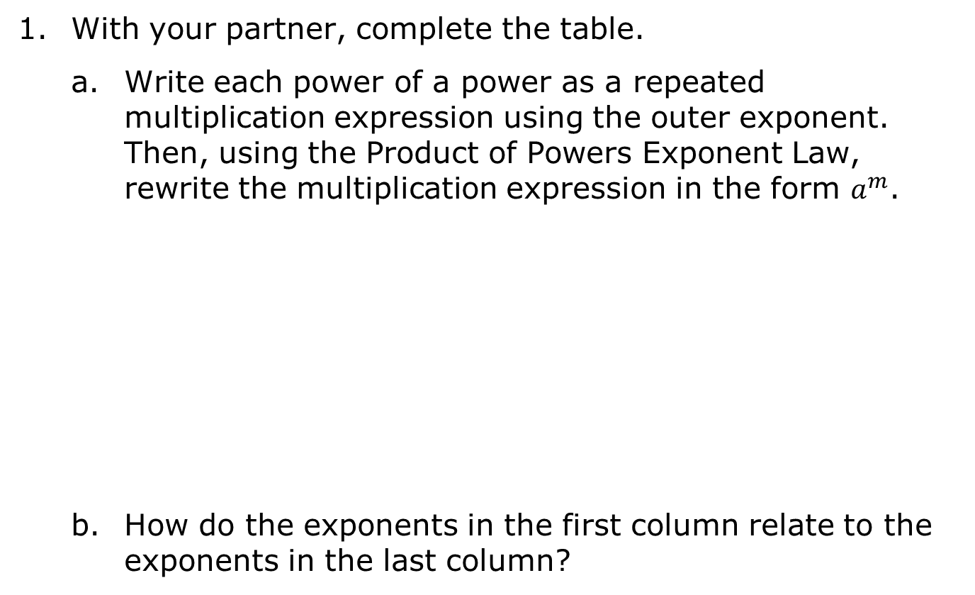
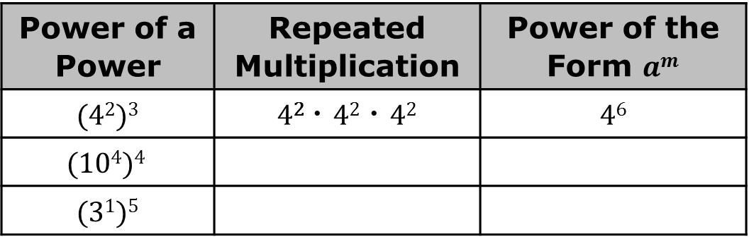
8.1.4 Exploration: Power of a Power Exponent Law
Power of a Power | Repeated Multiplication | Power of the Form $am$
(4²)³ | 4² ⠂4² ⠂4² | 4⁶
$$(104)4$$
(3¹)⁵
volume 2, pg. 7

Slide 25
Two different methods for evaluating expressions with exponents are illustrated in the table. With your partner, follow the steps.
Determine which column you will start in, and which column your partner will start in.
After finding the value of each expression, verify your answers are the same. If not, find the error(s).
After each problem, swap columns so that you and your partner are practicing both methods.
volume 2, pg. 7

Slide 26
Example | Method 1 | Method 2
 | [ (-2)⁴ ] ²
 | [ (-2)⁴ ] ² (16)² 16 ⠂16 256 | [ (-2)⁴ ] ² (-2)^{4 ⠂2} (-2)⁸ 256
 | [ (-6)¹ ] ⁸
 | [ (-10)² ] ⁶
volume 2, pg. 8

Slide 27
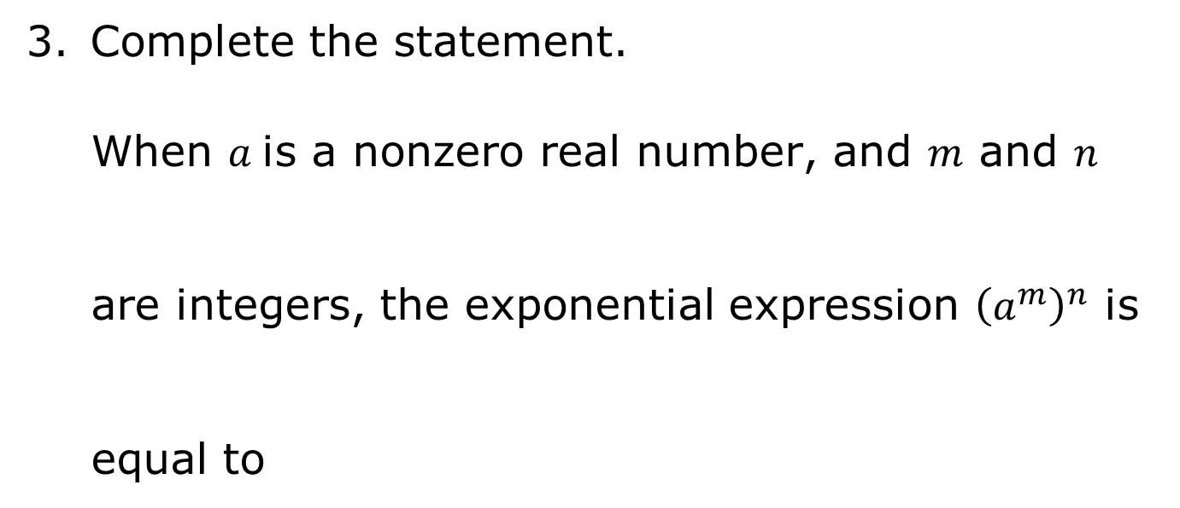
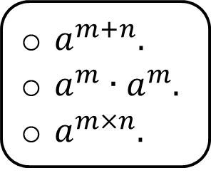
Power of a Power Exponent Law
When raising a base with a power to another power, multiply the exponents and keep the same base.
volume 2, pg. 8

Slide 28
Exploration
volume 2, pg. 8

Slide 29
8.1.5 Exploration: Identity Exponent Law
With your partner, use the meaning of an exponent to complete the table. Write each product as a repeated multiplication expression, then write the value of each expression.
Exponential Expression | Repeated Multiplication | Value
10¹ | 10 | 10
100¹
11¹
volume 2, pg. 8

Slide 30
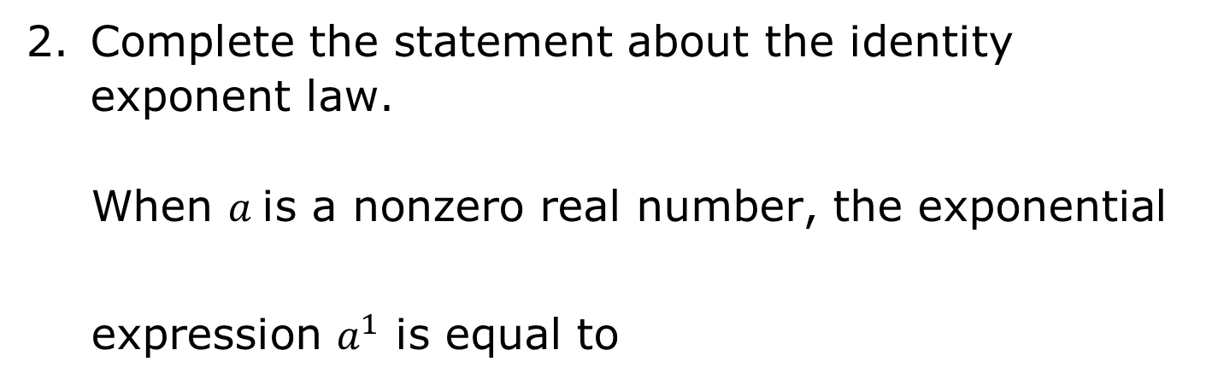
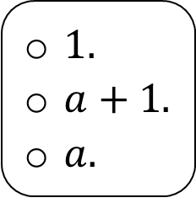
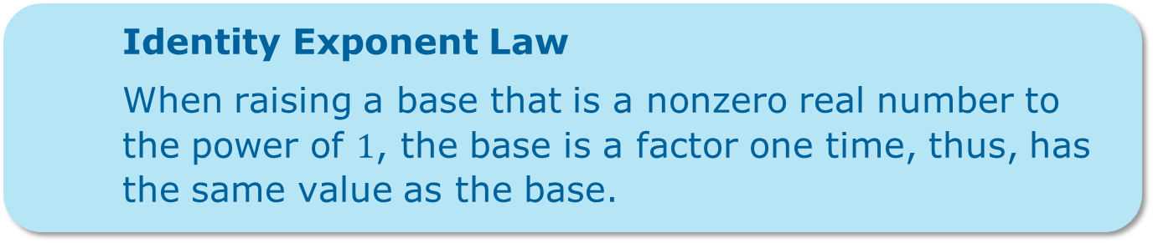

volume 2, pg. 8

Slide 31

Your Turn
volume 2, pg. 9

Slide 32
8.1.6 Your Turn!
Complete the following steps for each expression.
Rewrite each expression shown by using the laws of exponents.
Choose the exponent law you used from the list.
Evaluate the exponential expression.
(2³)⁴ | Product of powers law Power of product law Power of power law Identity exponent law
(2³)⁴ =
volume 2, pg. 9

Slide 33

0.5⁴ ⠂0.5³ | Product of powers law Power of product law Power of power law Identity exponent law
0.5⁴ ⠂0.5³ =
 | Product of powers law Power of product law Power of power law Identity exponent law
=
volume 2, pg. 9

Slide 34
(0.5 ⠂-8)² | Product of powers law Power of product law Power of power law Identity exponent law
(0.5 ⠂-8)² =
volume 2, pg. 9

Slide 35

Wrap-Up
volume 2, pg. 9

Slide 36


8.1.7 Wrap-Up: Ticket Out the Door
Rewrite the expressions using laws of exponents. State the exponent law used.
Expression | Exponent Law | Equivalent Expression
12.75⁵ ⠂12.75⁴
(12 ⠂0.75)³
285.6
10⁶ ⠂(-1.5)⁶
volume 2, pg. 9

